Slide 1
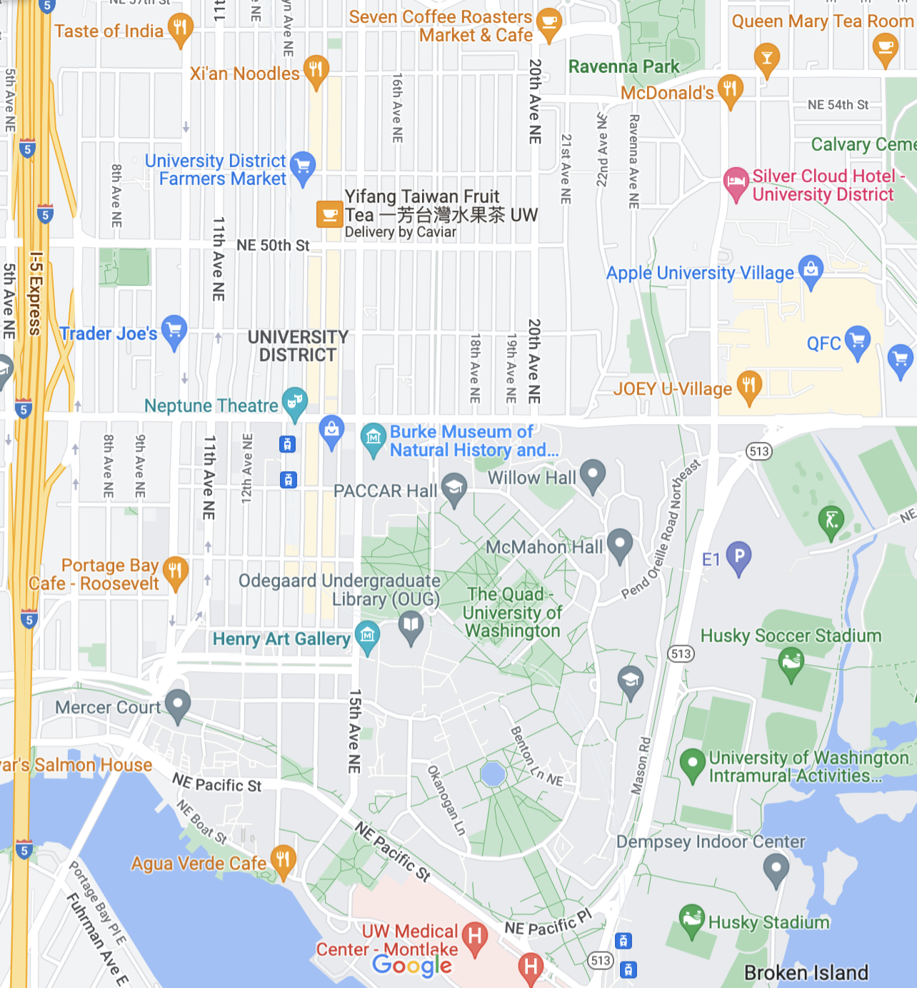
THE AVE
Roosevelt Way NE
University Village
25th Ave NE
NE 45th St
Campus Dining
Roosevelt Way NE
Montlake Blvd NE
Portage Bay

Slide 2
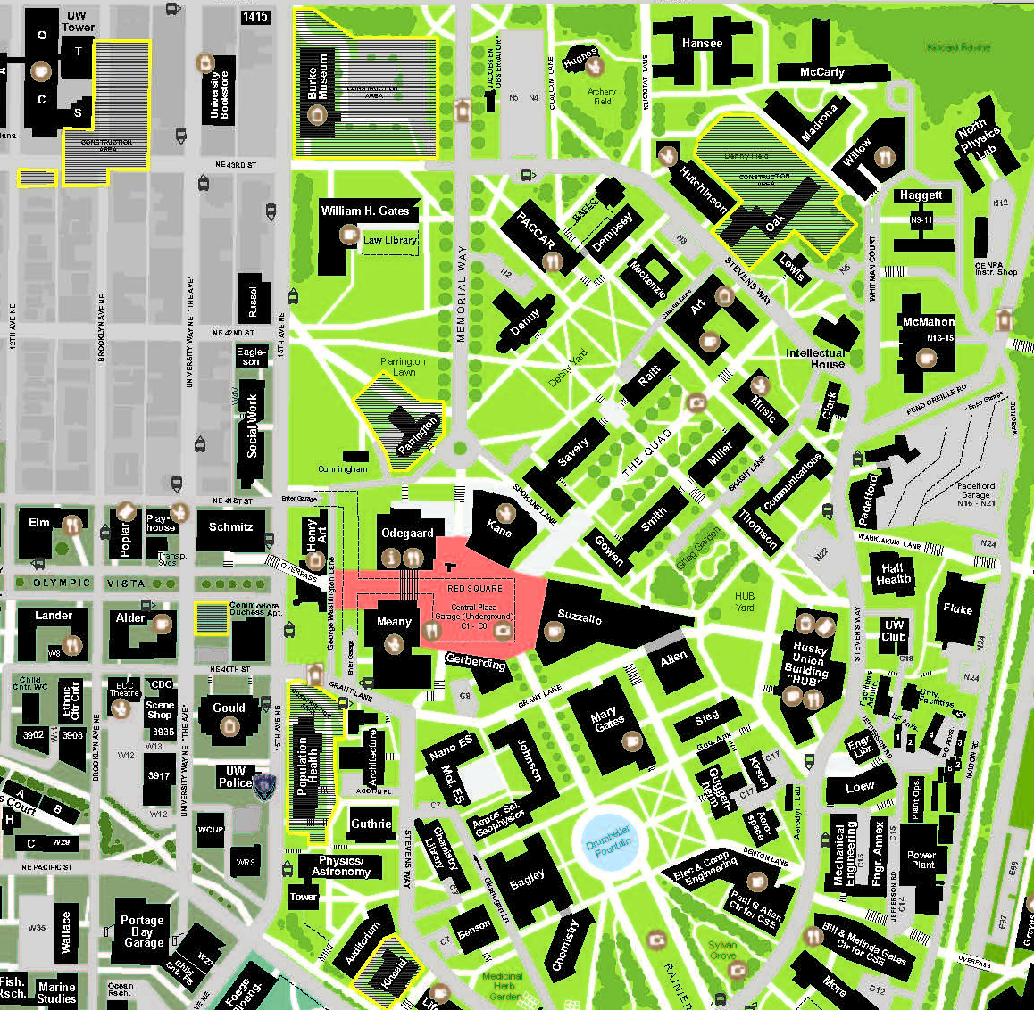
2
3
4
6
5
7
1
8

Slide 3
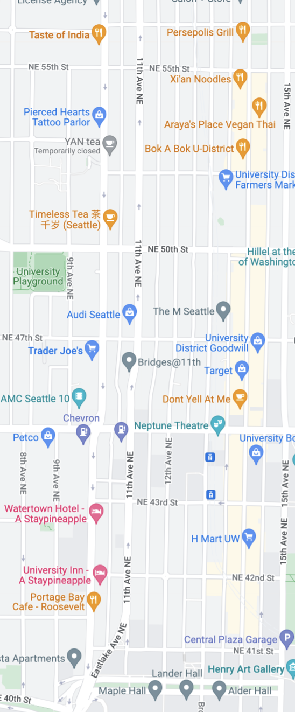
5
North Ave
Roosevelt Ave
4
Mid Ave
3
NE 45th St
Lower Ave
2
1

Slide 4
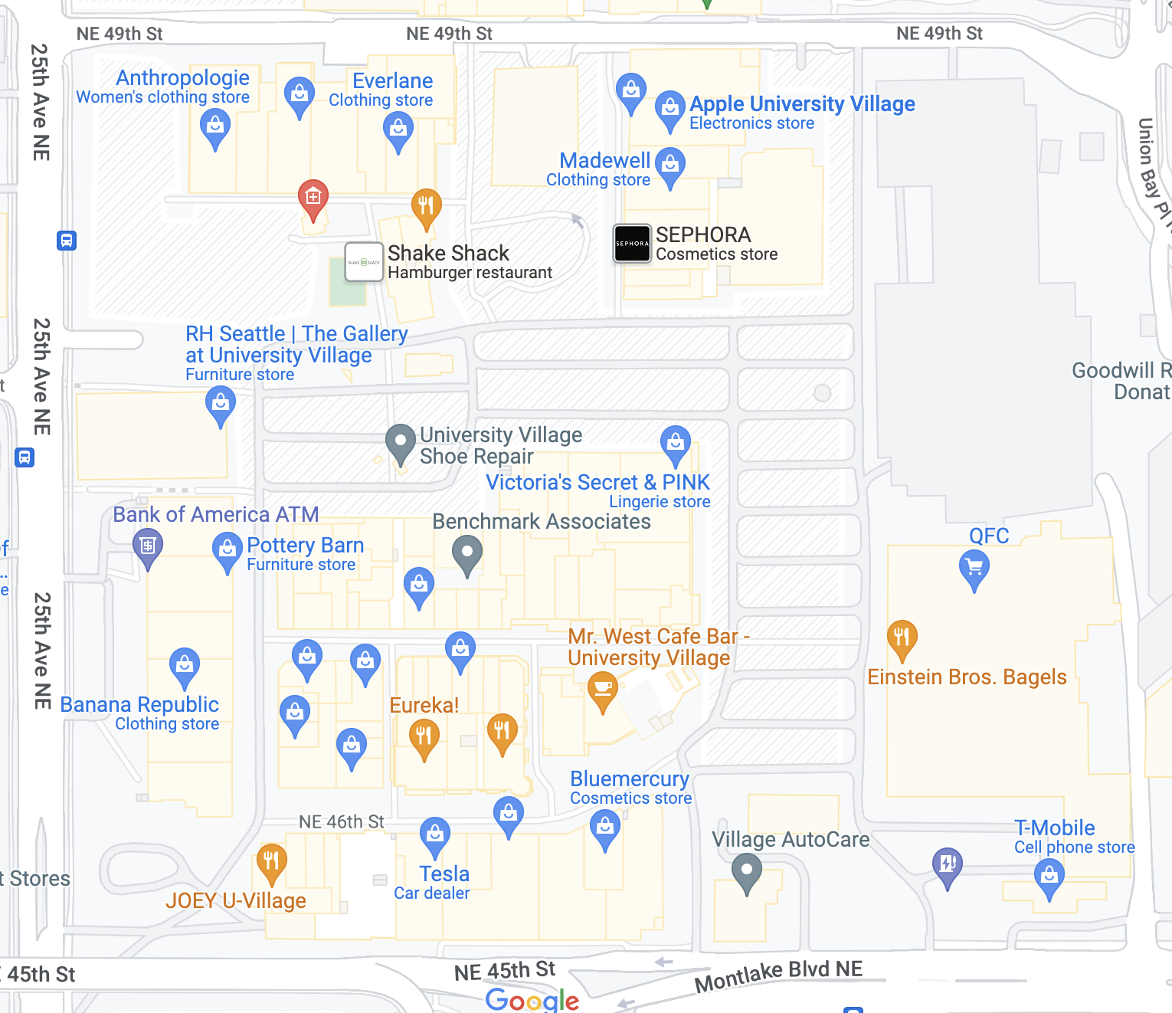
14
13
12
11
10
9
8
7
6
4
5
2
3
1

Slide 5
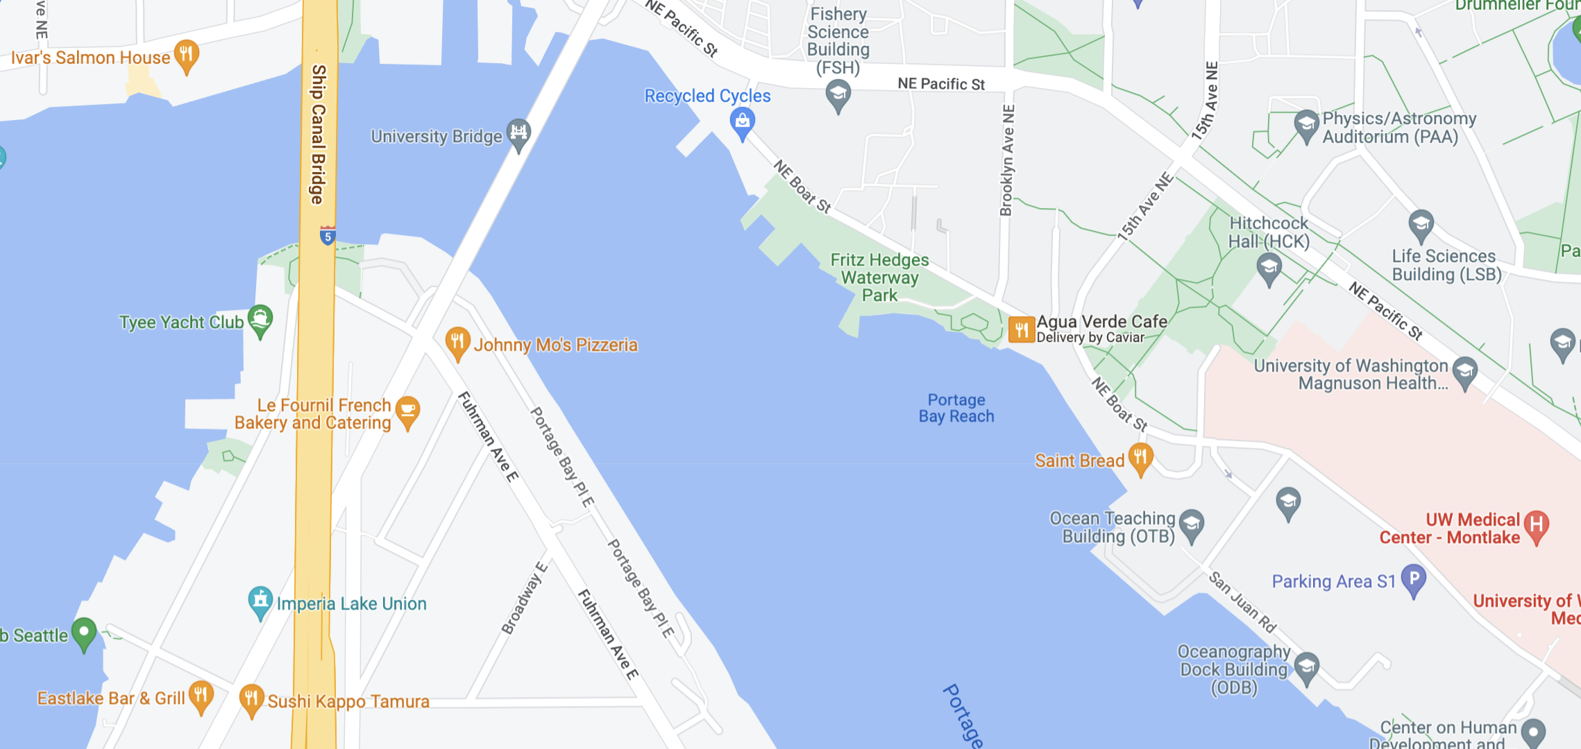
3
4
2
5
1

